Slide 1
Stringency and COVID-19
Andrew Eeckman | Beitong Li | Martin Marquez | Sriman Manyam

Slide 2
Introduction
Covid-19 is the largest pandemic of the modern world, and is having a severe worldwide impact.
The global challenge for the last year has been: How can we conquer Covid-19?
Our Question of interest:
Are rising levels of government stringency in response to COVID-19 associated with a decrease in its spread throughout a given country?
Our Hypothesis:
Yes, stricter responses are associated with a decreasing values of new cases in a given country.

Slide 3
Background
Our data involves utilizes 3 datasets:
1) WHO Covid-19 global dataset, measuring from Jan 3rd 2020 to today (updated daily)
Serves as a central repository for worldwide Covid-19 data
Provides daily and total transmission and mortality rates by country, from Jan 3rd 2020 to today
2) Oxford University Containment Index, measuring from Jan 1st 2020 to today (updated daily)
The containment index is a grade between 0-100 based on containment performance
It is cumulative score of 9 indicators, such as: school closures, travel bans, etc..
The dataset indicates each countries daily containment score
3) World Bank Global Population dataset
Contains recorded population by country 1960-2019

Slide 4
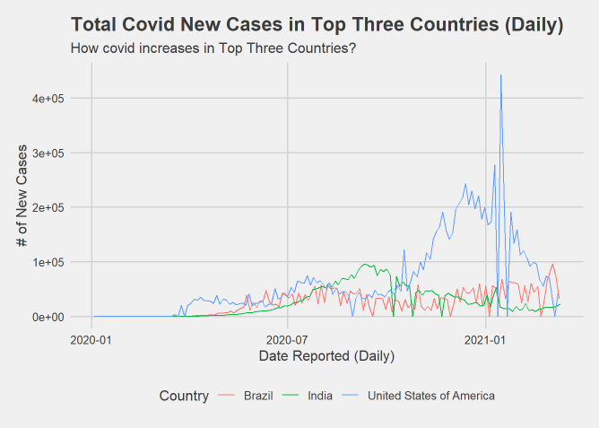
Descriptive Analysis (Brief Summarization)
Up to February 28th, 2021 Worldwide:
Accumulated New Covid Cases: 114,853,685
Accumulated Death Covid Cases : 2,554,694
Infection Fatality Ratio (IFR, in %)：2.224%

Slide 5
Descriptive Analysis (Brief Summarization)
Country | USA | Brazil | India
Accumulated New Cases | 28,174,978 | 10,455,630 | 11,096,731
Country / Worldwide | 24.53% | 9.10% | 9.66%
*Up to February 28th 2021, the top three worst-hit countries accumulated 43.30% of the total worldwide new Covid cases.
Potential Reasons:
Common-sense solutions were undercut or ignored.
The spread of Covid-19 misinformation.
The shortage in medical device.

Slide 6
Descriptive Analysis
Our question of interest concerns two primary variables: ‘new_cases’ and ‘containment_index’
Both variables come from separate datasets, we’ll need to merge them before conducting our analysis
However, some basic data wrangling must take place first and throughout this process in order to get unbiased and consistent results

Slide 7
Descriptive Analysis (Data Wrangling)
COVID-19 infections can last up to a month or more if symptoms are severe
Thus, restrictions put in place on any given day are not likely to impact the number of new cases for about four weeks
Cannot join ‘new_cases’ and ‘containment_index’ by the same date, results will not be consistent
Solution: match new cases from a given date to containment indices four weeks prior
covid$Date_of_Restrictions <- covid$Date - 28

Slide 8
Descriptive Analysis (Data Wrangling)
With this offset accounted for, we can now begin to merge the two datasets from before.
We will do so by matching the rows of each datasets by date and country (for the WHO dataset, the date used will be the ‘Date_of_Restrictions’ variables calculated in the previous slide)
covid_index <- merge(covid, c_h_index, by.x = c("Date_of_Restrictions", "Country"), by.y = c("Date", "Country"))
For the next step, we will also add population numbers to the above dataset storing now instead as covid_index_pop

Slide 9
Descriptive Analysis (Data Wrangling)
Countries with larger populations are likely to have, on average, a higher number of new cases per day. The opposite is true for countries with smaller populations
Analyzing this data, then, without accounting for country-specific population will yield biased and misconstrued results
Solution: scale the number of new cases by each country’s specific population (numbers gathered from 2019 statistics)
covid_index_pop$new_cases_div_by_pop <-
covid_index_pop$New_cases / covid_index_pop$Population

Slide 10
Descriptive Analysis
‘containment_index’ is a continuous variable ranging from 0 to 100 where 0 is the most lenient and 100 is the most strict
We want to organize countries by the varying degrees of this variables. In order to do so, we will need to transform ‘containment_index’ into a categorical variable
Now we must decide on what levels to choose for each variable
Let’s start by looking at ‘containment_index’’s distribution

Slide 11
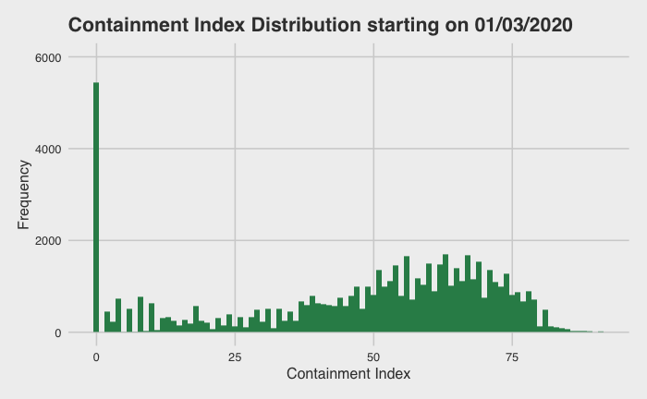
Descriptive Analysis (Data Visualization)
With dates starting on 01/03/2020, one value stands out from the rest, 0
On this date, COVID-19 was not yet considered a major global threat
Worldwide cases: <400
Another start date should be chosen

Slide 12

Descriptive Analysis (Data Visualization)
On 01/30/2020, there were a total of 6,102 cases worldwide and WHO declared the virus to be a global threat
Most countries, however, still had not yet contracted a single case, so the high number of 0s still makes sense
Another date should be tried

Slide 13
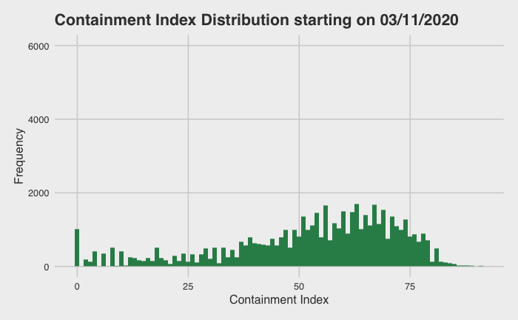
Descriptive Analysis (Data Visualization)
On 03/11/2020, the WHO declared COVID-19 to be a global pandemic
Few countries after this point had containment indices equal to 0
This data thus may be better to source from when attempting to identify varying levels of containment

Slide 14
Descriptive Analysis (Categorization)
We used the following code to determine the bounds of each level for our new categorical variable of ‘containment_index’
quantile(covid_post_0311$containment_index, c(0.2, 0.4, 0.6, 0.8))
Yielding the following values:
20% | 40% | 60% | 80%
38.46 | 51.96 | 61.54 | 69.23

Slide 15
Descriptive Analysis (Categorization)
Using the cut function and assigning its return value to a new variable called ‘containment_index_leveled’ we receive the following levels to be analyzed
0 - 38.46 | 38.46 - 51.92 | 51.92 - 61.54 | 61.54 - 69.23 | 69.23 - 100
Lenient | Lenient_Mod | Moderate | Mod_Strict | Strict

Slide 16
Inferential Analysis
Conducting Two-Way ANOVA Model to test influence of leveled containment index
ANOVA Assumptions:
Data points that are used are relevant in regards to the question being asked
Response variable is continuous
Response variable follows a normal distribution
Variance of the data in different groups is the same
Ho: Containment level index is not correlated with change in new COVID-19 cases
Ha: At least one index level is correlated with the change in cases.

Slide 17
Inferential Analysis
Two-Way ANOVA Table
 | Df | Sum Sq | Mean Sq | F value | Pr (>F)
containment_index_leveled | 4 | 0.000055 | 1.375e-05 | 739.78 | <2e-16
Country | 150 | 0.0002691 | 1.794e-06 | 96.49 | <2e-16
Residuals | 60671 | 0.0011278 | 1.900e-08
* All Values Shown at 95% Significance Level

Slide 18
Inferential Analysis
Having proved that different containment index levels are associated with varying numbers of new cases (scaled by their respective populations) per country, we can now move on to determining what exactly those differences are
Using the following code we can obtain a table listing out these differences
TukeyHSD(two_way_anova, "containment_index_leveled")

Slide 19
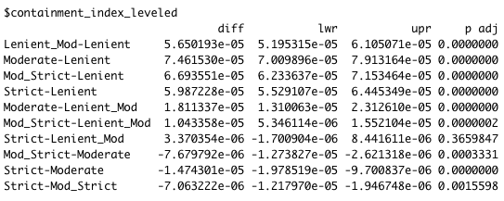
Inferential Analysis

Slide 20
Inferential Analysis
When moving from lenient containment levels to more strict containment levels, it appears that the number of new cases actually increases
This is with the exception of the following: when moving from both Moderate and Mod_Strict to Strict, and when moving from Moderate to Mod_Strict.
Due to these mix results, we cannot confirm our hypothesis. The exceptions list above support it but the norm appears to be against it.
These results make sense, however, as when cases are rising, a country is likely to impose harsher restrictions which may not come in time to have an effect on the spread.

Slide 21
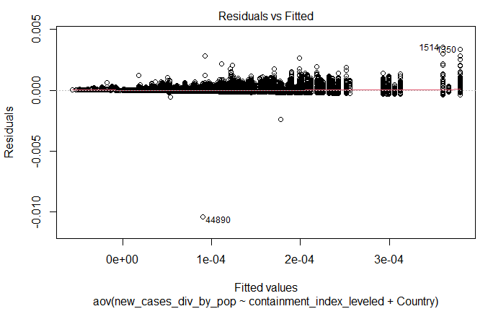
Sensitivity Analysis
Residual vs Fitted Plot
The residual values majorly fall above the 0 line.
The spreading pattern gets wider toward a larger x values.
The absolute value of the residuals is strongly positively correlated with the fitted values.

Slide 22
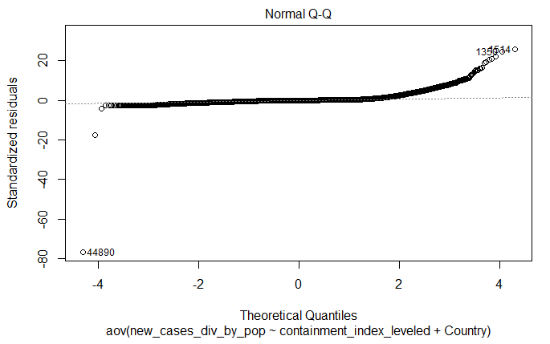
Sensitivity Analysis
Normal Q-Q Plot
The residuals deviate from the diagonal line mostly in the upper tail.
The residuals appear to be larger in magnitude than expected from the normal distribution.

Slide 23
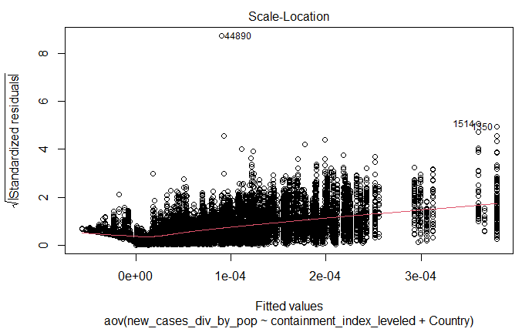
Sensitivity Analysis
Scale-Location Plot
The residuals are not spread equally and the red smooth line is steep.

Slide 24
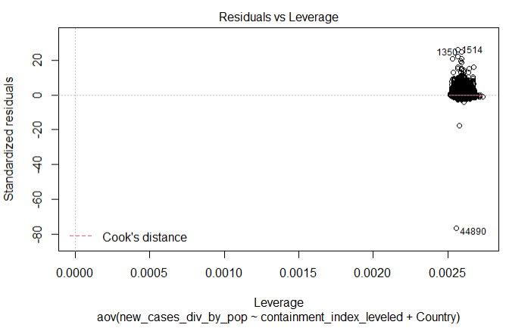
Sensitivity Analysis
Residuals vs Leverage Plot
Point #44890 is identified as the influential observation.

Slide 25
Sensitivity Analysis
Two Possible Methods to Improve Sensitivity Test:
Method 1:
Perform transformation on the dependent and/or independent variables, such as logarithm, square root, square, etc.
Method 2:
Explore the reason for the outliers. Remove the outliers and fit the model again.
*Method 2 is preferred.

Slide 26
Discussion
Although we attempted to correct for potential problems without our model such as the influence of population and the longevity of COVID-19 infections, our results were ultimately inconclusive.
Several factors could be behind this, one of the most prominent being cognitive dissonance where people had originally followed COVID-19 guidelines but after a few months of lockdown began to tire of them.
A follow-up study could be done where the data is divided up by the month so as to analyze the effect of containment indices on a shorter time scale and to potentially see where individuals may have started disregarding guidelines.
Answering this question is very important and will help us understand the best way to prevent the spread.

Slide 27
Question 1:
Why did your team decide to choose the ANOVA model for your analysis? What were the advantages and disadvantages for doing so? If you could do this project over would you have chosen a different model?
ANOVA Model is a parametric test, making it very powerful with a normally distributed dataset (which we had). Also, this model allowed us to test the overall equality of means by group and gain further insights. A disadvantage for ANOVA modelling is that a regression model could’ve been used which would’ve allowed us to view the containment analysis on a continuous scale rather than by groups. If we could redo the project we would chose a MLR model as it might give us more of a definitive statistically significant answer to our proposed question.

Slide 28
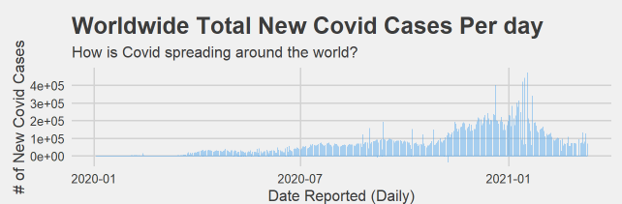
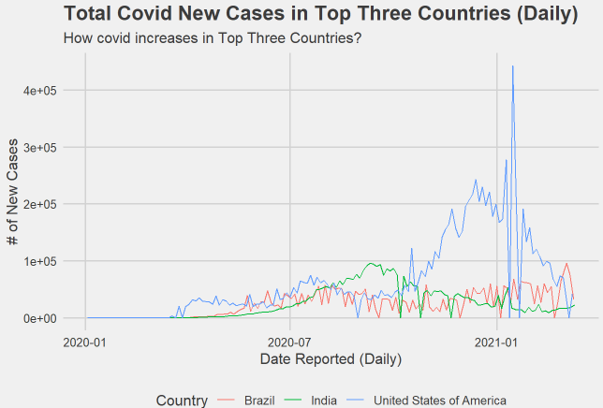
Question 2:
How do the top three countries (The United States of America, Brazil, and India) with the most accumulated new COVID-19 cases compared with the overall worldwide trend?

Slide 29
Question 3:
What are some important factors to consider other than those already included in your current analysis?
Weather: Based on our

Slide 30
Question 4:
Based on our analysis, what strategies can your team propose to help deal with combating the spread of COVID-19?
1) Quarantine: It is widely accepted that the vast majority of Covid-19 transmissions are person to person. Theoretically, it should follow that if person to person contact is reduced effectively or removed altogether, most avenues of transmission would no longer exist.
2) Vaccinations/Herd Immunity: We know after exposure, individuals retain antibodies for a not yet reliably known amount of time. Likewise, vaccines ideally result in the individual building antibodies. Regardless of the form, both of these minimize the size of the population that can succumb to Covid-19.
Realistically, some mixture of these three factors will likely be the method for reducing Covid-19’s spread in the current timeline. In the long run, vaccines will hopefully be able to prevent the spread of Covid-19.

Slide 31
Question 5:
How is the containment index calculated by Oxford university? Does your team agree with this method of calculation?
Calculated by factoring 9 distinct indicators - including decay of rate of spread, school/business closures, and domestic/international travel restrictions. While it isn’t a perfect algorithm, this method of calculation is consistent and includes a majority of the main factors involved in a country’s response to COVID-19, thus we do in fact agree with this method.

